Slide 1
Hiring Process Analytics project

Slide 2
Project description
Hiring process is the fundamental and the most important function of a company. Here, the MNCs get to know about the major underlying trends about the hiring process. Trends such as- number of rejections, number of interviews, types of jobs, salaries , vacancies etc. are important for a company to analyse before hiring freshers or any other individual. Thus, making an opportunity for a Data Analyst job here too! Being a Data Analyst,our job is to go through these trends and draw insights out of it for hiring department to work upon.

Slide 3
Approach
Data Collection: Gather given data and other application details, interview feedback, and hiring outcomes and import in excel.
Data Cleaning and Preparation: Remove duplicates, handle missing values, and format data for analysis.
Exploratory Data Analysis: Identify trends, patterns, and correlations in candidate characteristics and hiring outcomes.
Statistical Analysis: Apply statistical techniques to analyze data and identify factors influencing successful hires.
Data Visualization: Create visual representations of findings to facilitate understanding and decision-making.
Implementation and Tracking: Collaborate with the hiring team to implement changes and monitor their impact..

Slide 4
tech stack used
The tech stack used in a hiring data analytics project include
.MS EXCEL:-
Excel functions and formulas for data cleaning, removing duplicates, handling missing values, and formatting data.
Excel's data analysis tools, such as pivot tables, charts, and filters, to explore trends, patterns, and correlations in the data.
Statistical Analysis: Excel's built-in statistical functions and formulas for analyzing data, calculating descriptive statistics, and conducting basic statistical tests.

Slide 5
insights
Hiring Process Analytics project provide valuable information for optimizing recruitment. They identify areas to improve, reduce time-to-hire, and enhance candidate selection. These insights also support diversity and inclusion efforts. By making data-driven decisions, organizations can refine their recruitment strategies, attract top talent, and build a successful and inclusive workforce..

Slide 6
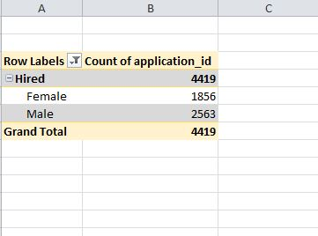
1. Hiring: Process of intaking of people into an organization for different kinds of positions. Your task: How many males and females are Hired ?
There are 1856 female and 2563 males are hired.

Slide 7
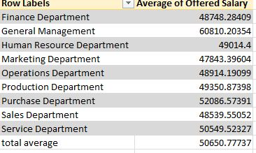
2.Average Salary: Adding all the salaries for a select group of employees and then dividing the sum by the number of employees in the group.
The average salary of all departments are 50650.77

Slide 8
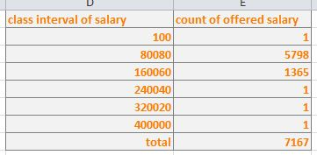
3.Class Intervals: The class interval is the difference between the upper class limit and the lower class limit. Your task: Draw the class intervals for salary in the company ?
Different salary slab with number of candidate of the slab are diaplayed here

Slide 9
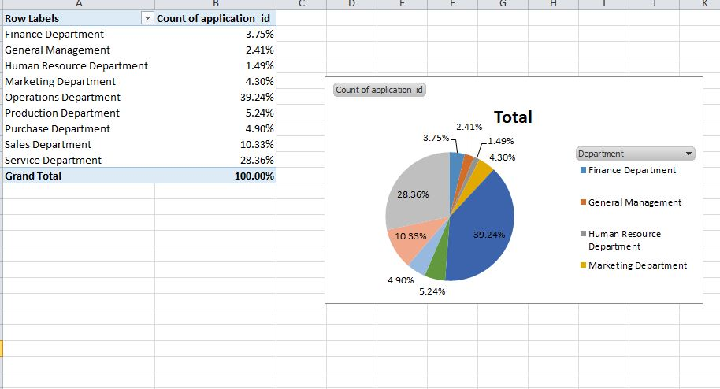
4.Charts and Plots: This is one of the most important part of analysis to visualize the data. Your task: Draw Pie Chart / Bar Graph ( or any other graph ) to show proportion of people working different department ?
Percentage of peoples working in different departments

Slide 10
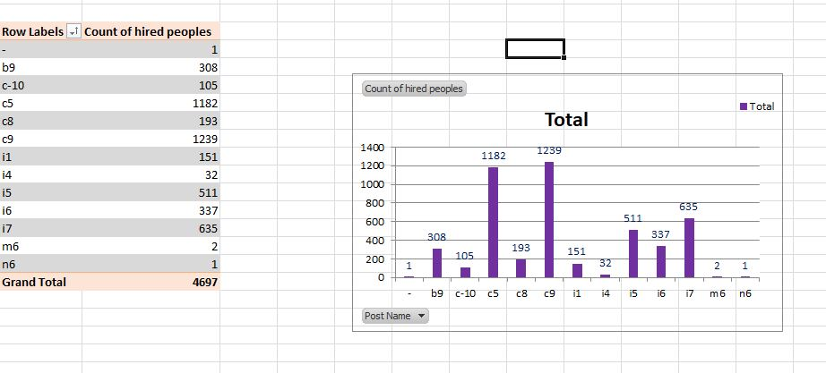
5. Charts: Use different charts and graphs to perform the task representing the data. Your task: Represent different post tiers using chart/graph?
Number of people working in different posts

Slide 11
result
The results of a hiring data analytics project provide useful information for improving the hiring process. This includes insights on what qualifications lead to successful hires, how to hire more efficiently, and how to create a diverse workforce. These findings help companies make better hiring decisions and build a stronger team.

Slide 12
The end
Thanks.
Here is the drive link provided of the project
https://docs.google.com/presentation/d/1G5SAxELONKAYsFkdoTJrHalZG_wrZI0Y/edit?usp=sharing&ouid=102798538525957876779&rtpof=true&sd=true

